Slide 1

DATA ANALYTICS
Final Project
Turning raw data into actionable insights using Data Analytics

Slide 2

PROJECT TITLE
STUDENT PERFORMANCE &
BEHAVIOR ANALYSIS
Python-Based Data Analytics Project to Explore the factors associated with academic performance
Presented by - Arya R
Tools: Python | Pandas | NumPy | Matplotlib | Seaborn

Slide 3
Agenda Slide
Project Objectives
Filtering Data
Statistical Summary
Data Sources & Collection
Aggregating Data
Correlational Analysis
Dataset Overview
Exploratory Data Analysis
Visualizations
Data Cleaning & Preprocessing
Univariate Analysis
Project phases
Data Pre-Processing Overview
Bivariate Analysis
Key Insights
Derived columns
Multivariate Analysis
Recommendations and Conclusion

Slide 4
Project Objectives
Understand the structure and quality of the student dataset
Student academic performance is influenced by several factors such as study habits, attendance, previous academic performance and behavioral characteristics. This project analyzes student performance and behavioral data to identify important patterns, relationships and factors associated with academic outcomes.
Using Python, Pandas, NumPy, Matplotlib, Seaborn, and Plotly, the analysis covers data cleaning, exploratory data analysis, statistical analysis, visualization and insight generation.
Clean and preprocess the data for reliable analysis
Explore demographic, academic and behavioral patterns
Generate actionable insights and recommendations

Slide 5

Data Source & Collection
Dataset Information
Dataset name : Students Performance Dataset
SOURCE
  Kaggle
  Dataset Link : https://www.kaggle.com/datasets/mahmoudelhemaly/students-grading-dataset/data?utm_source

Slide 6
Dataset Overview
Total number of Values : 115000
Number of Rows : 5000
Number of Columns : 23
Academic
Behavioral
Background
  Midterm Score
  Final Score
  Assignments
  Quizzes
  Study Hours
  Attendance
  Stress
  Sleep
  Extracurricular Activities
  Gender
  Department
  Parent Education
  Family Income
  Internet Access
  Projects
  Participation
  Total Score
  Grade

Slide 7
Data Cleaning & Preprocessing
The raw dataset was systematically cleaned and prepared for analysis by checking data types, identifying missing values and duplicate records, and applying appropriate preprocessing techniques. Relevant transformations and derived features were then created to improve the quality and usability of the data. This process converted the raw student data into a reliable, analysis-ready dataset for further exploration
Remove duplicates and errors
Handle missing values
Normalize and standardize data

Slide 8
Data Pre-Processing Overview
Metric
Status
Missing values
1,025 null values handled
Duplicates
0 duplicates
Data Type Correction
Corrected
Data Validation
Validated
Outlier Validation
Validated

Slide 9
Derived columns
New derived columns were created to improve the analysis
and provide better insights into student performance and behavior
Full Name
Performance Category
Age Group
Stress Category
Attendance Status
Sleep Category

Slide 10
Filtering Data
1
Filtering based on Total Score
3
Filtering based on Internet Access
Top Performers: 16 students were identified as top performers by filtering records with a Total Score above 90
2,520 students have internet access, while 2,480 do not, enabling comparison of academic and study patterns
2
Filtering based on Gender
4
Filtering based on Sleep and Stress
2,449 female students and 2,551 male students were identified for further comparative analysis
313 students had ≤5 hours of sleep and stress levels ≥8, enabling analysis of their academic performance

Slide 11
Aggregating Data
Aggregate by department
To compare academic performance and attendance across departments
Aggregate by Grade
To compare student distribution, academic performance, and attendance across grades
Academic performance and Average Sleep
To compare average sleep duration across performance categories
Gender wise Average Score
To compare average academic performance between male and female students

Slide 12
Exploratory Data Analysis
Patterns were explored at three levels, supported by groupby, pivot tables, correlation and statistical summaries.
Univariate
Bivariate
Multivariate
One variable at a time: frequency counts, percentages, mean, median, std, quartiles
Two variables: categorical vs numerical group means, and numerical vs numerical correlation
Three or more variables: pivot tables and multi-measure groupby summaries
9
5
5
12
Categorical variables profiled
Groupby summaries
Pivot tables
Variables in correlation matrix

Slide 13
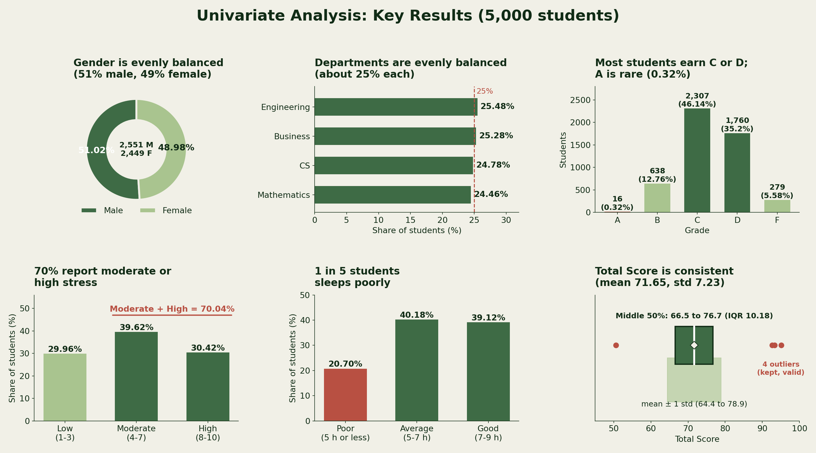
Univariate Analysis
Key Takeaways
Gender and departments are evenly balanced
Most students earn C or D; A is rare (0.32%)
70% students- moderate or high stress
1 in 5 students sleeps poorly
Total Score is consistent

Slide 14
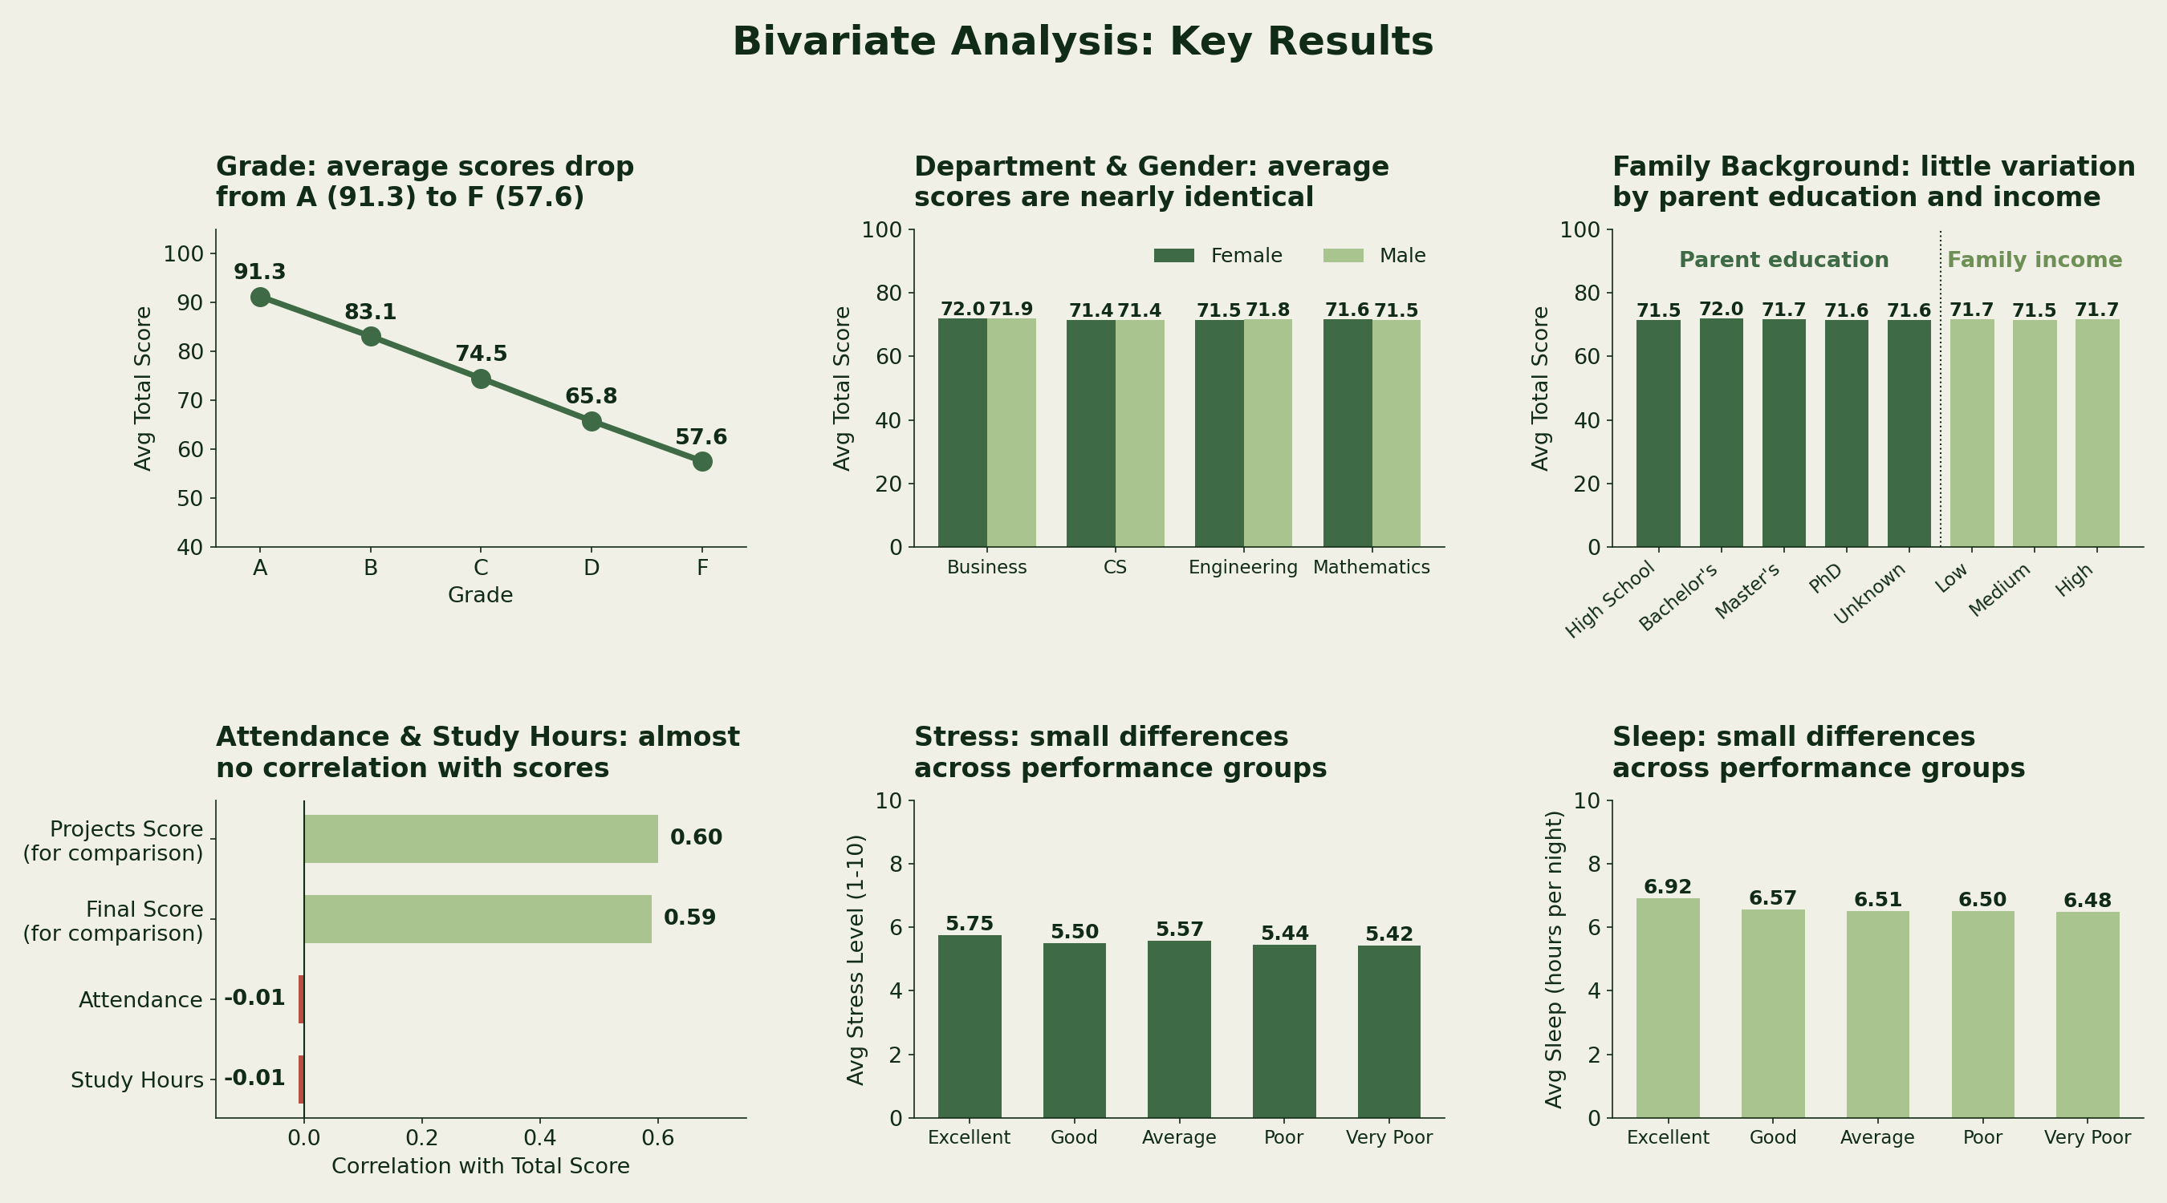
Bivariate Analysis
Key Takeaways
Grade: Average scores drop from A (91.3) to F (57.6).
Department & Gender: Average scores are nearly identical.
Family Background: Parent education and income have little impact on average scores.
Attendance & Study Hours: Almost no correlation with scores.
Stress & Sleep: Small differences across performance groups

Slide 15
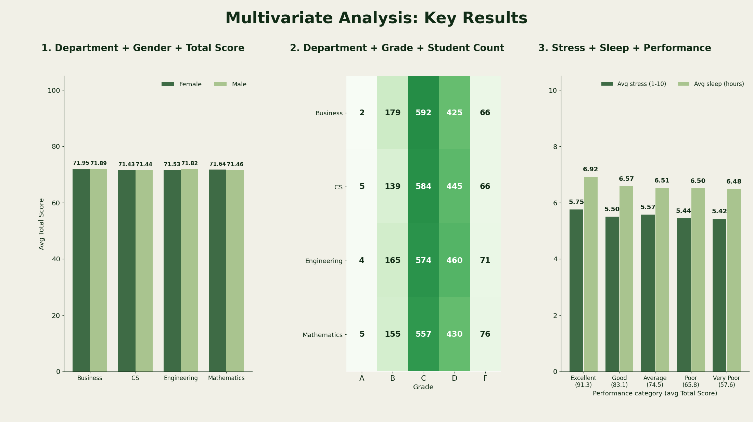
Multivariate Analysis
Key Takeaways
Overall: Department, gender, stress, and sleep have little effect on scores in this dataset
Excellent group: Only 16 students are in this group, so their results should be interpreted carefully

Slide 16
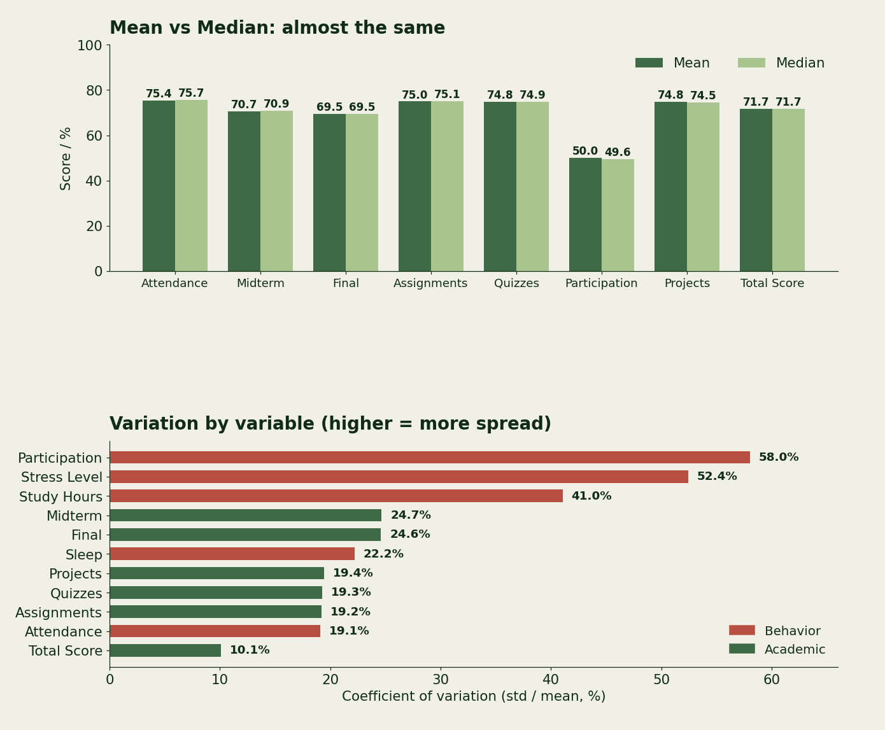
Statistical Summary
10.18
4
IQR of Total Score
IQR outliers, all retained
Key Takeaways
Mean and median are almost the same
Assignments, quizzes, and projects average around 75
Total Score has the least variation
Participation has the most variation
Behavioral factors varies more than academic factors

Slide 17
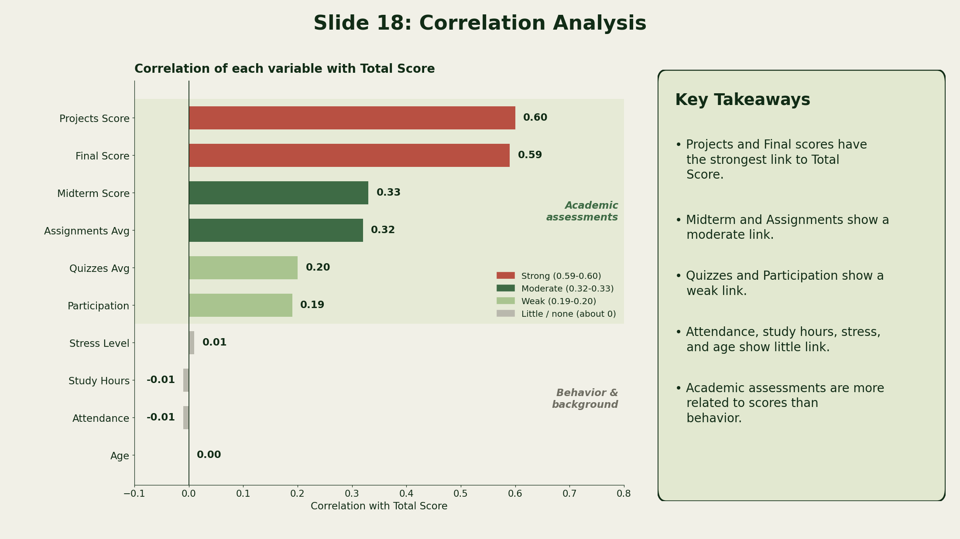
Correlation Analysis
Key Takeaways
Projects and Final scores have the strongest link to Total Score
Midterm and Assignments show a moderate link
Quizzes and Participation show a weak link
Attendance, study hours, stress, and age show little link
Scores depends more on Academic assessments than behavioral factors

Slide 18
Visualizations
Visuals built with Matplotlib, Seaborn and Plotly, each with titles, labels and colour schemes
Distributions
Comparisons
Relationships
- Bar plot
- Horizontal bar
- Pie chart
- Histogram
- KDE plot
- Count plot
- Violin plot
- Grouped bar
- Line plot
- Stacked % bar
- Box plots
- Scatter plot
- Regression plot
- Correlation heatmap
- Pairplot
- 2x2 subplots
- Interactive Plotly

Slide 19
Project Phases
TASK 1
TASK 2
NEXT TASK
Problem Definition & Dataset Selection
Data Cleaning & Pre-processing
Exploratory Data Analysis
• Defined the problem & objectives
• Selected a relevant dataset
• 5,000 records & 23 features
• Handled missing values
• Verified duplicates
• Validated data quality
• Corrected data types
• Created derived features
• Prepared analysis-ready data

Slide 20
Key Insights
1. Grade Matters Most
2. Projects Lead the Way
Grade the strongest indicator of overall academic performance
Projects show the strongest link with overall performance
3. Final Exams Matter
4. Gender Makes Little Difference
Final exam scores are also strongly linked to Total Score
Male and female students have nearly identical scores
5. Department Has Limited Impact
6. Attendance Isn’t a Strong Driver
Average scores remain close across departments
Attendance shows almost no link with Total Score
7. Study Time Isn’t Everything
8. Well-being Shows Small Differences
Study hours show very little relationship with scores
Stress and sleep levels change only slightly across performance groups

Slide 21
Recommendations
Recommendations
Next Steps
Focus on Projects – Use more practical projects to strengthen learning and performance
Support Final Exam Preparation – Provide revision plans and practice assessments
Identify Struggling Students Early – Monitor students with consistently low grades
Encourage Consistent Academic Work – Give regular assignments, quizzes, and feedback
Monitor Student Well-being – Keep track of stress and sleep as supporting factors
Build an Early-Warning System – Identify students who may need academic support.
Track Performance Over Time – Compare student progress across semesters.
Explore More Factors – Analyse factors such as learning methods, motivation, and family support.
Create Personalized Support – Use student-level insights to plan targeted interventions.
Collect More Data – Add future-semester data to validate and improve the findings.

Slide 22
Conclusion
This analysis highlights the key academic and student factors linked with performance and shows how data can support early identification, targeted support, and better learning outcomes
5,000
29
20
8
Records analysed
Columns after cleaning
Visualizations
Key insights
Thank you

